Slide 1

Presentation On Scholarship Calculator
Presented by –
Group 9
Presented to –
Dr Mukesh Joshi

Slide 2
Team Members
Project Supervisor
Dr. Mukesh Joshi
Assistant Professor
GEHU, Bhimtal
Project link:
https://gehu-scholarship.herokuapp.com/
Github link :
https://github.com/tf153/Gehu-Scholarship/
S. No. | Name | University Roll number
1 | Priyanka Joshi | 2062394
2 | Rahul Joshi | 2061711
3 | Rahul Mehta | 2061712
4 | Rashmi Satwal | 2061713

Slide 3
Presentation Outline
Introduction
Objectives
Academic Objectives
Uses
Technological Platforms Used
Languages Used
Salient Features
Application Snapshots
Conclusion

Slide 4
Introduction
Online Scholarship calculator website is a convenient and an efficient way of getting accurate information about the scholarship and hence, the fee structure of the respective Graphic Era University.
Web development has become increasingly powerful in the recent years.
Our project motivation is to convert manual and computational problems into an easy online accurate solution.
By using this website, anyone can get required information at anytime and anywhere at the ease of just of search away.

Slide 5
Objectives
To provide the accurate and instant information about the scholarship and fee structure according to the respective campuses.
To avoid confusion among the students regarding the fee structure.
To filter out the eligible students according to the terms and conditions for the scholarship criteria.

Slide 6
Academic Objectives
Learn the process of the implementation of various programming languages used in Web Technology.
Understanding the working and application of Web Development.
Designing and developing web pages.
Learning and working together in a team via online medium.
Utilizing the minimum resources while working online within a given period of time.
Finally, developing a website which can be accessed by everyone for free.

Slide 7
Uses
Gives a clear idea about the fee structure and scholarship offered to the students according to their performance in the previous semester and other applicable scholarships.
Gives precise information to the new students wanting to join the university beforehand.
Avoids the need to personally go to the university head office or reception in order to get the complete details, you can do it online at home.

Slide 8
Technological Platforms Used
Git Hub : for doing and keeping a record of the collective team work.
MS Teams : for communicating together online and screen sharing for collective ideas.
Eclipse : for trying, testing and implementing different ideas altogether.
Heroku : For online deploying the website.
freedb.tech : for online database creation.

Slide 9
Languages Used
HTML (HyperText Markup Language)
PHP ( HyperText Preprocessor)
Javascript
For styling : CSS (Cascading Style Sheets)
Database used : MySQL

Slide 10
Salient Features
Effective and efficient way of getting accurate details.
Extra technical knowledge is not required to operate the system.
Available at anytime, anywhere and to anyone.

Slide 11
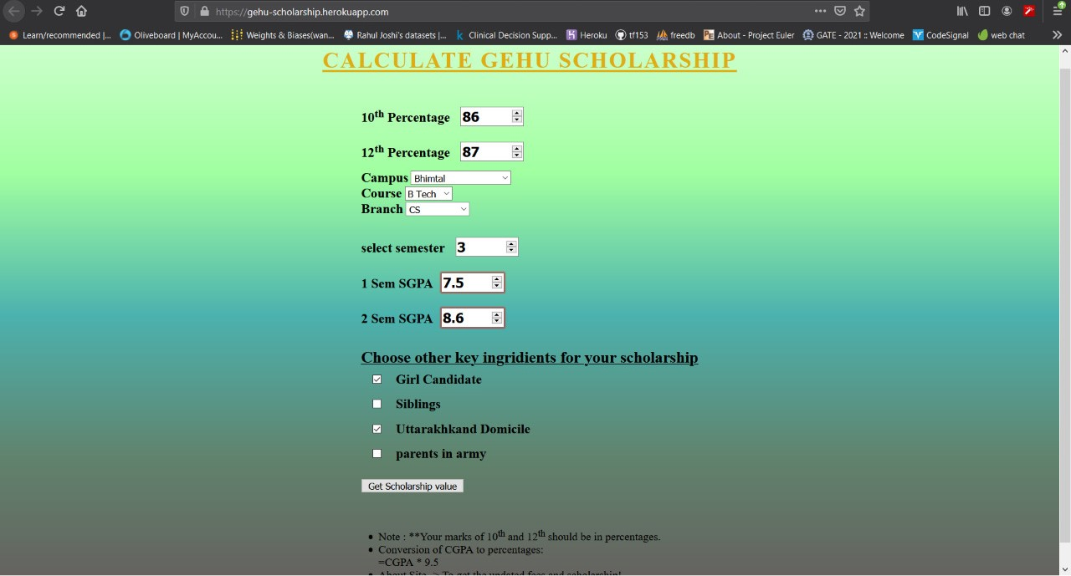
Application Snapshots

Slide 12
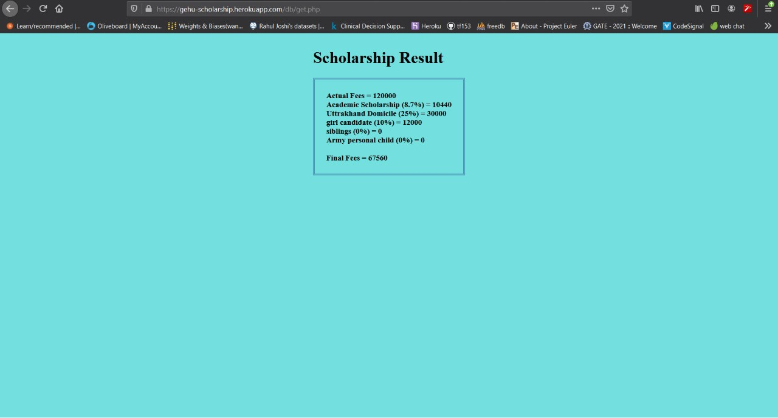
Application Snapshots

Slide 13
Conclusions
The project exposed us to the latest technology in the areas of web development.
Thus, this project successfully demonstrates an online based scholarship calculator.
We faced many challenges and problems during the development time.
It was a nice learning curve to work on web technology aplications.

Slide 14


